Slide 1
Database Management System
Md. Manowarul Islam
Lecturer
Dept. of CSE
Jagannath University.

Slide 2
SQL Constraints
We will focus on the following constraints:
  NOT NULL
  UNIQUE
  PRIMARY KEY
  FOREIGN KEY
  CHECK
  DEFAULT

Slide 3
SQL Constraints
The CHECK Constraint enables a condition to check the value being entered into a record.
If the condition evaluates to false, the record violates the constraint and isn't entered the table.

Slide 4
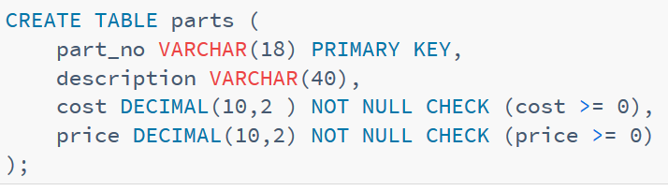
SQL CHECK Constraint
CREATE TABLE Persons
(
P_Id int NOT NULL CHECK (P_Id>0),
LastName varchar(255) NOT NULL,
FirstName varchar(255),
Address varchar(255),
City varchar(255)
)

Slide 5
Let’s create a table
CREATE TABLE Employee (
EmpID INT(11) NOT NULL PRIMARY KEY,
Name VARCHAR(30) NOT NULL,
AGE INT NOT NULL CHECK (AGE >= 18)
);
Column level
CREATE TABLE Employee1(
EmpID INT(11) NOT NULL PRIMARY KEY,
Name VARCHAR(30) NOT NULL,
AGE INT NOT NULL,
Address VARCHAR(30) NOT NULL,
CHECK (AGE >= 18)
);
Table level

Slide 6
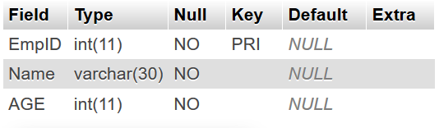
Let us do some exercise
Create a table called customer

Slide 7
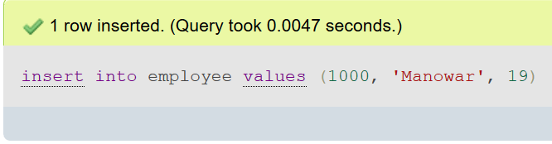
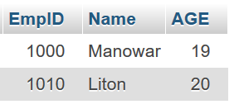
Insert item
insert into employee values
(1000, 'Manowar', 19)
insert into employee values
(1010, 'Liton', 20)

Slide 8
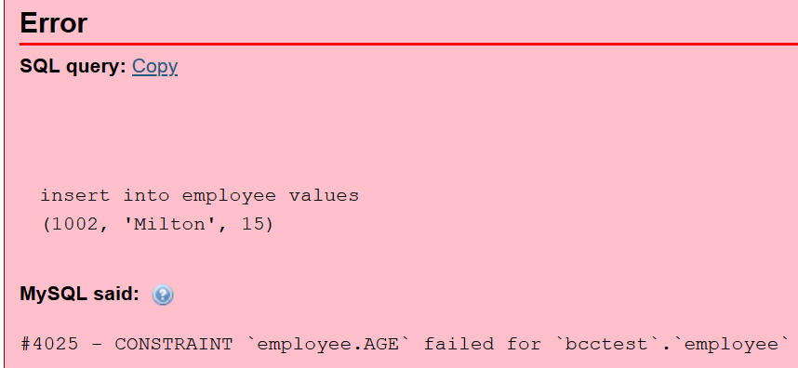
Insert item age<18
insert into employee values
(1002, 'Milton', 15)

Slide 9
Alter table
ALTER TABLE Employee MODIFY AGE INT NOT NULL CHECK (AGE >= 18 );
ALTER TABLE Employee
ADD CONSTRAINT myCheckConstraint CHECK(AGE >= 18);

Slide 10
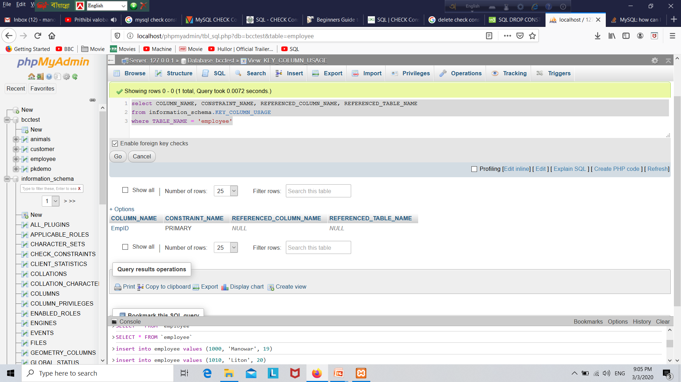
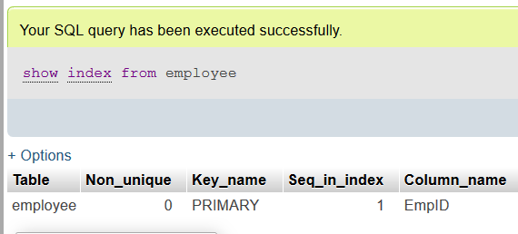
select COLUMN_NAME, CONSTRAINT_NAME, REFERENCED_COLUMN_NAME, REFERENCED_TABLE_NAME
from information_schema.KEY_COLUMN_USAGE
where TABLE_NAME = 'employee'

Slide 11

CMD (Method-1)
+ R
C:\Users\Islam>cd c:
C:\Users\Islam
C:\Users\Islam>cd ..
C:\Users>cd ..
C:\>cd xampp
C:\xampp>cd mysql
C:\xampp\mysql>cd bin
C:\xampp\mysql\bin>mysql.exe -u root -p
Enter password:
Welcome to the MariaDB monitor. Commands end with ; or \g.
Your MariaDB connection id is 439
Server version: 10.4.11-MariaDB mariadb.org binary distribution
Copyright (c) 2000, 2018, Oracle, MariaDB Corporation Ab and others.
Type 'help;' or '\h' for help. Type '\c' to clear the current input statement.
MariaDB [(none)]>
Show create table employee

Slide 12
CMD (Method-2)
Setting environment for using XAMPP for Windows.
Lab-2@DESKTOP-UGV9ION c:\xampp
# cd mysql
Lab-2@DESKTOP-UGV9ION c:\xampp\mysql
# cd bin
Lab-2@DESKTOP-UGV9ION c:\xampp\mysql\bin
# mysql.exe -u root -p
Enter password:
Welcome to the MariaDB monitor. Commands end with ; or \g.
Your MariaDB connection id is 439
Server version: 10.4.11-MariaDB mariadb.org binary distribution
Copyright (c) 2000, 2018, Oracle, MariaDB Corporation Ab and others.
Type 'help;' or '\h' for help. Type '\c' to clear the current input statement.
MariaDB [(none)]>

Slide 13
CMD
MariaDB [(none)]> show databases;
+--------------------+
| Database |
+--------------------+
| bcctest |
| information_schema |
| mysql |
| performance_schema |
| phpmyadmin |
| test |
+--------------------+
6 rows in set (0.001 sec)
MariaDB [(none)]> use bcctest;
Database changed
MariaDB [bcctest]>

Slide 14
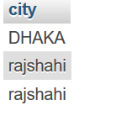
As enum
create table tb1(
city varchar(250) NOT NULL CHECK (city IN ('Rangpur','Dhaka','Rajshahi'))
)
insert into tb1 values('DHAKA')
insert into tb1 values('rajshahi')
insert into tb1 values('rajshahi')
Select * from tb1;

Slide 15
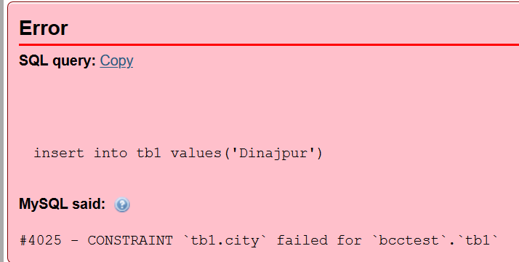
As enum
insert into tb1 values('Dinajpur')

Slide 16
As enum
create table gender(
gen varchar(20) NOT NULL check (gen='M' OR gen='F')
);
insert into gender values('m');
√
insert into gender values(‘M');
√
insert into gender values(‘R');
X

Slide 17
Thanks a lot

